Slide 1

Daniel Choi
Sean Kelley
Robert Hromada
David Su
Mike Turley
Colby Stone
Yue Shing

Slide 2
Team Roles
Colby Stone
Sean Kelley
David Su
Yue Shing
Mike Turley
Daniel Choi
Robert Hromada
Project Manager
Creative Director
FrontEnd Programmer
FrontEnd Programmer
BackEnd Programmer
BackEnd Programmer
Documentation Scribe

Slide 3
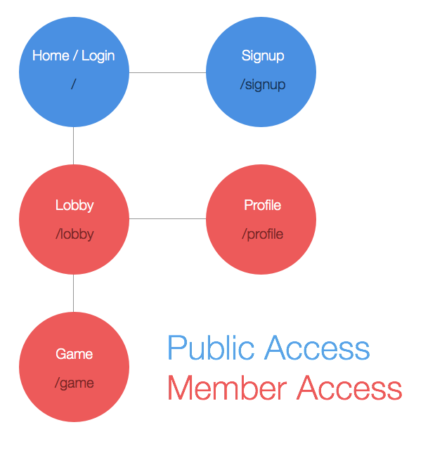
Birds Eye View

Slide 4
Overview
???

Slide 5
Problems
Team members took different directions on how game would be played out.
Delegation of work was low in beginning which lead to too much catchup later in development
Absenteeism from class and group meeting lead to some members lack of understanding
Massiveness of project and libraries was difficult to learn

Slide 6
Not Implemented
Cards against Humanity style game was re-visioned into mad-lib style game
Implementing our own logo/avatar feature was abandoned for Gravatar web-service

Slide 7
Future Content
Custom, player made, stories
Different game modes/ styles of mad-libs
Profanity Filter
Larger database of stories

